Slide 1
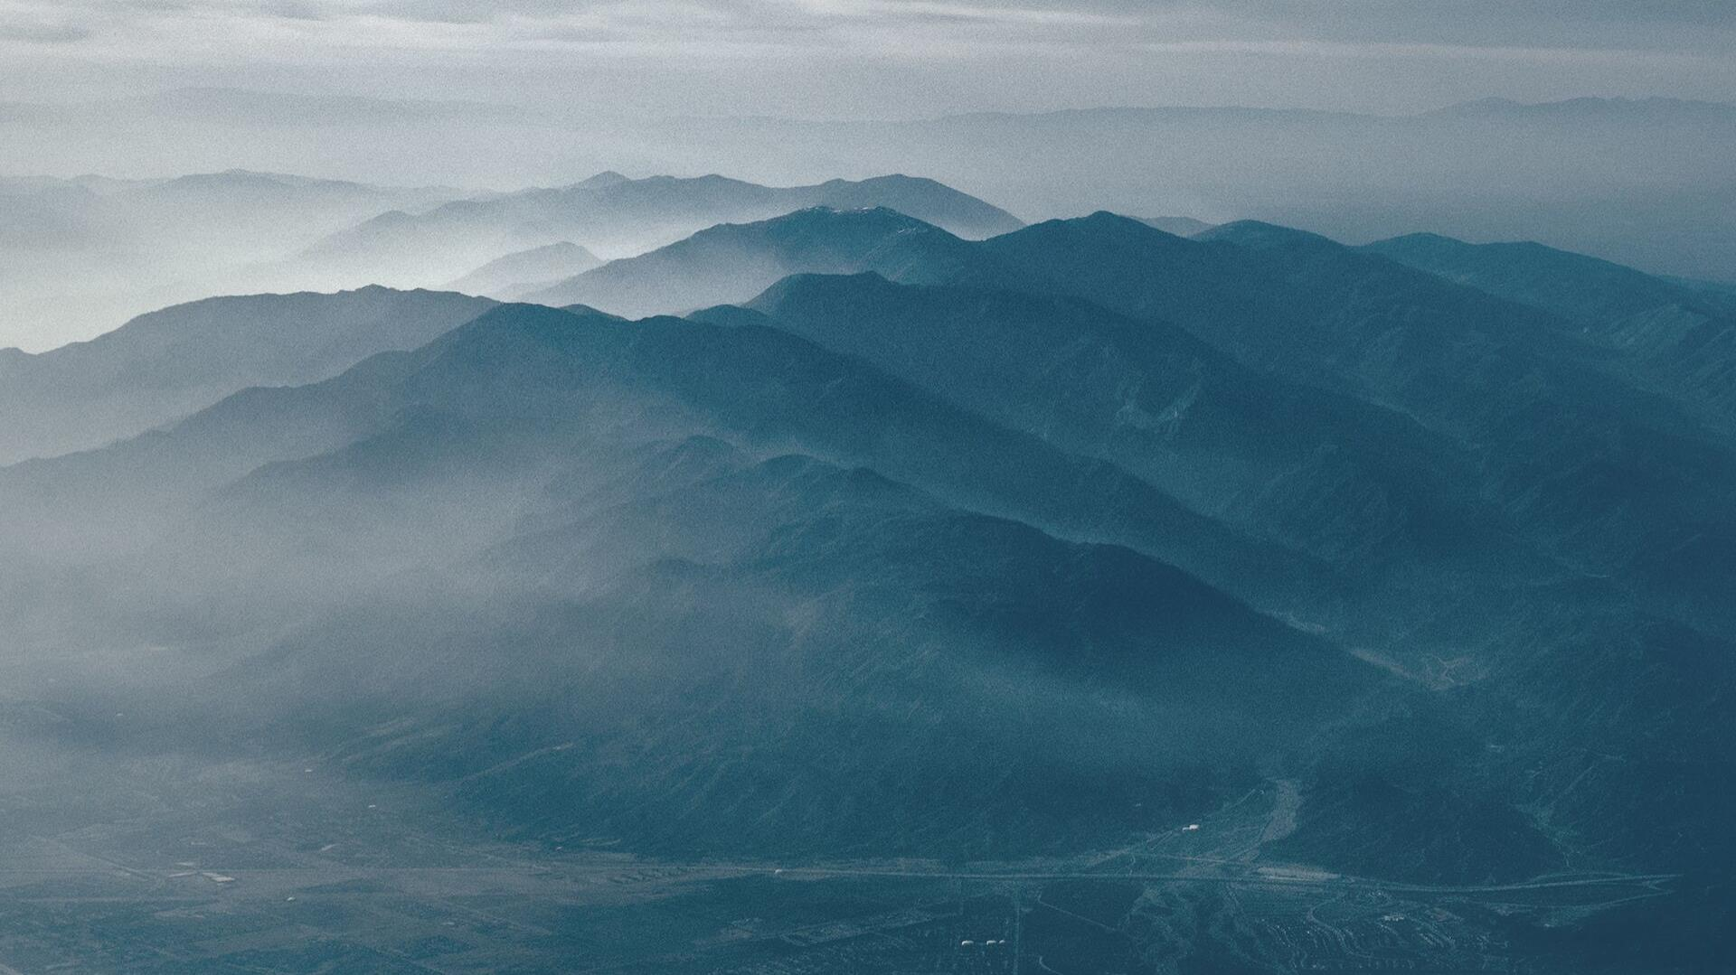


Slide 2


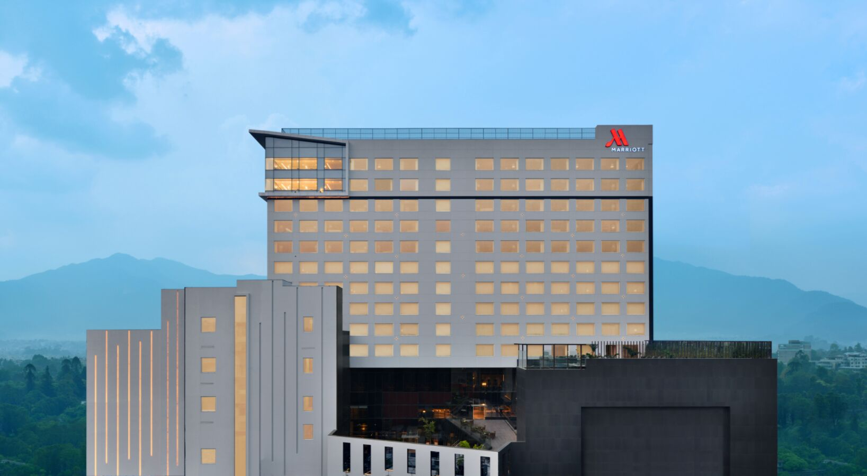
EXPERIENCE NEPAL LIKE NEVER BEFORE

Slide 3
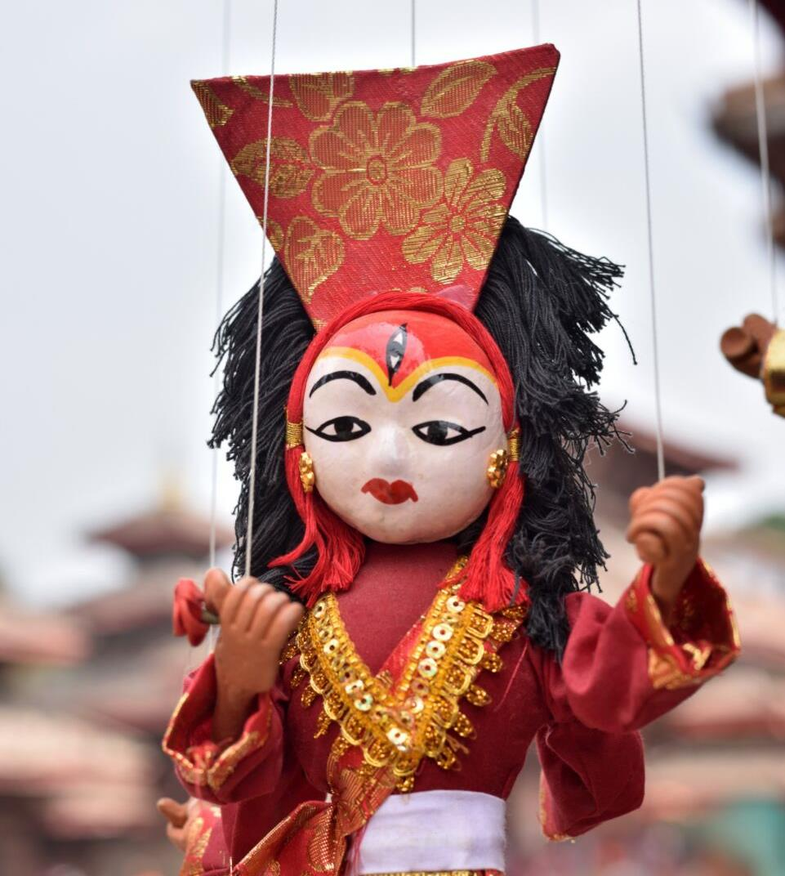
KATHMANDU - LAND OF THE LIVING GOD
Kathmandu is an incredibly diverse historic city with breathtaking Newari architecture, centuries old Hindu and Buddhist religious sites along with dedicated tourist-friendly accommodations and restaurants.
Stepping into Kathmandu is like stepping into another world that everybody should experience at least once in their lifetime.

Slide 4
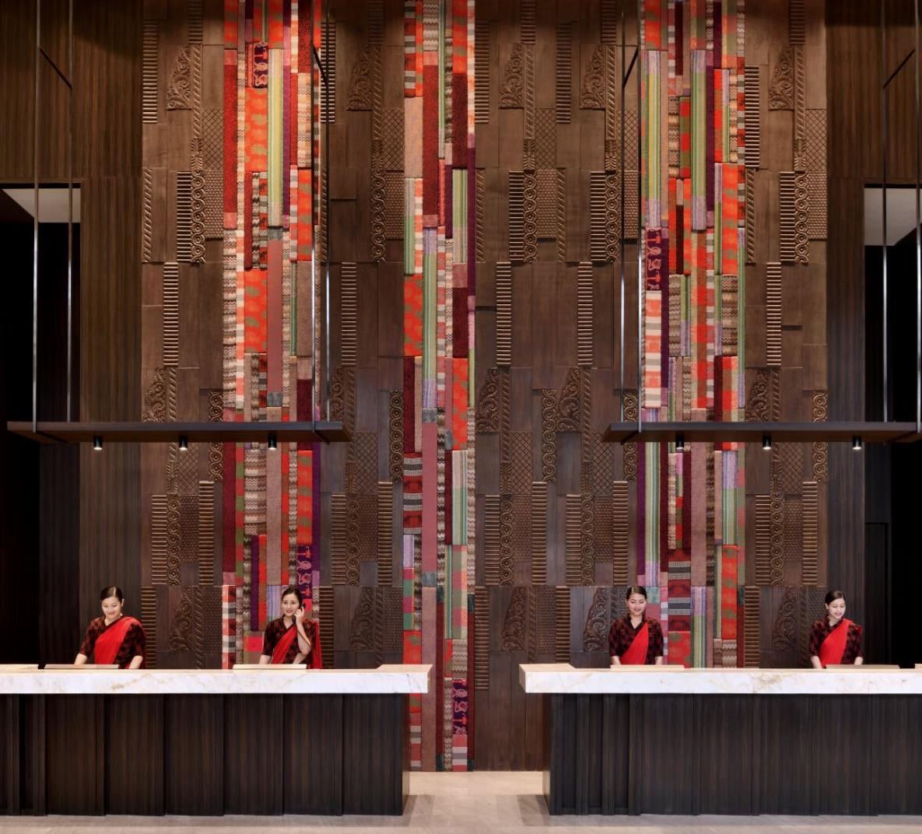
KATHMANDU MARRIOTT HOTEL
Kathmandu Marriott Hotel, a 214-room contemporary hotel in the capital city Kathmandu, combines modern design with local creativity. The elegantly appointed rooms with warm colors add a charm, which is perfectly complemented by our caring service. Home to an inviting range of restaurants, the hotel also takes a fresh approach to dining experiences.

Slide 5
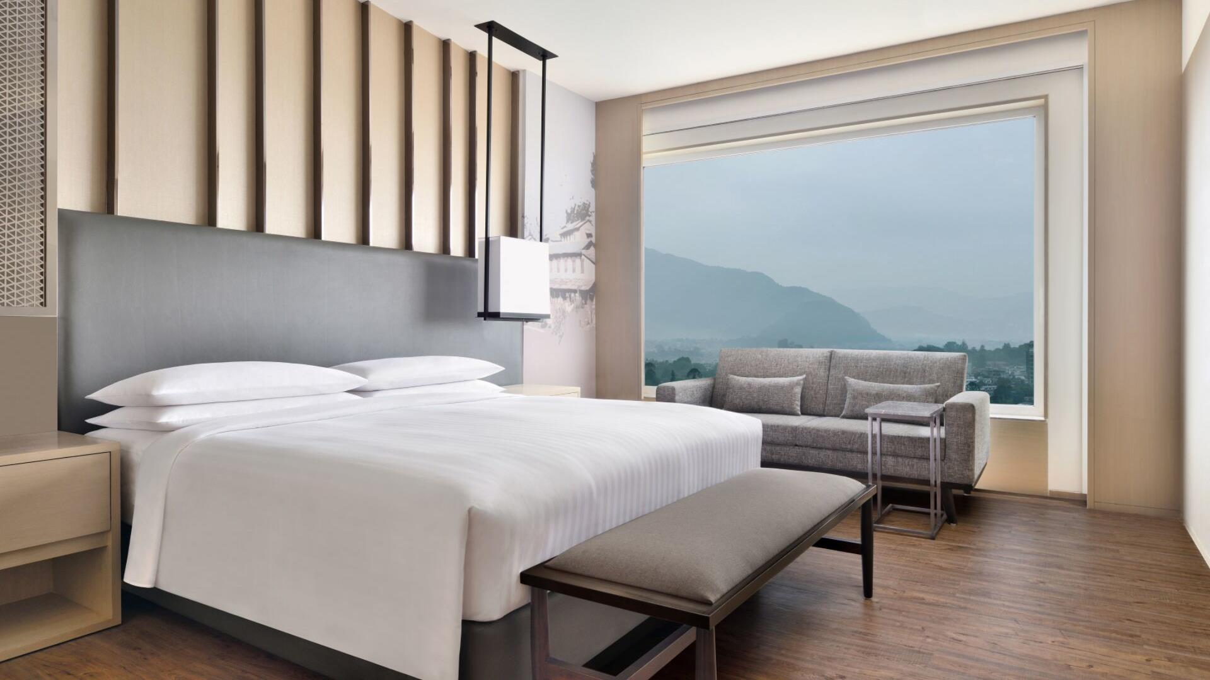
ACCOMMODATION
Rooms
• 214 Rooms
• 191 Deluxe Rooms
• 32 Club Rooms
• 10 Junior Suites
• 10 Executive Suites
• 1 Presidential Suite
Guest Room Features
• Four fixture bathroom
• Room service, 24-Hour
• Air-conditioning
• Remote Curtain Control
• Bottled Water
• Tea/coffee maker
• Complimentary Wi-Fi
• Built in room safe
• Mini-bar
• Baby cribs (subject to availability)
EXECUTIVE SUITE

Slide 6
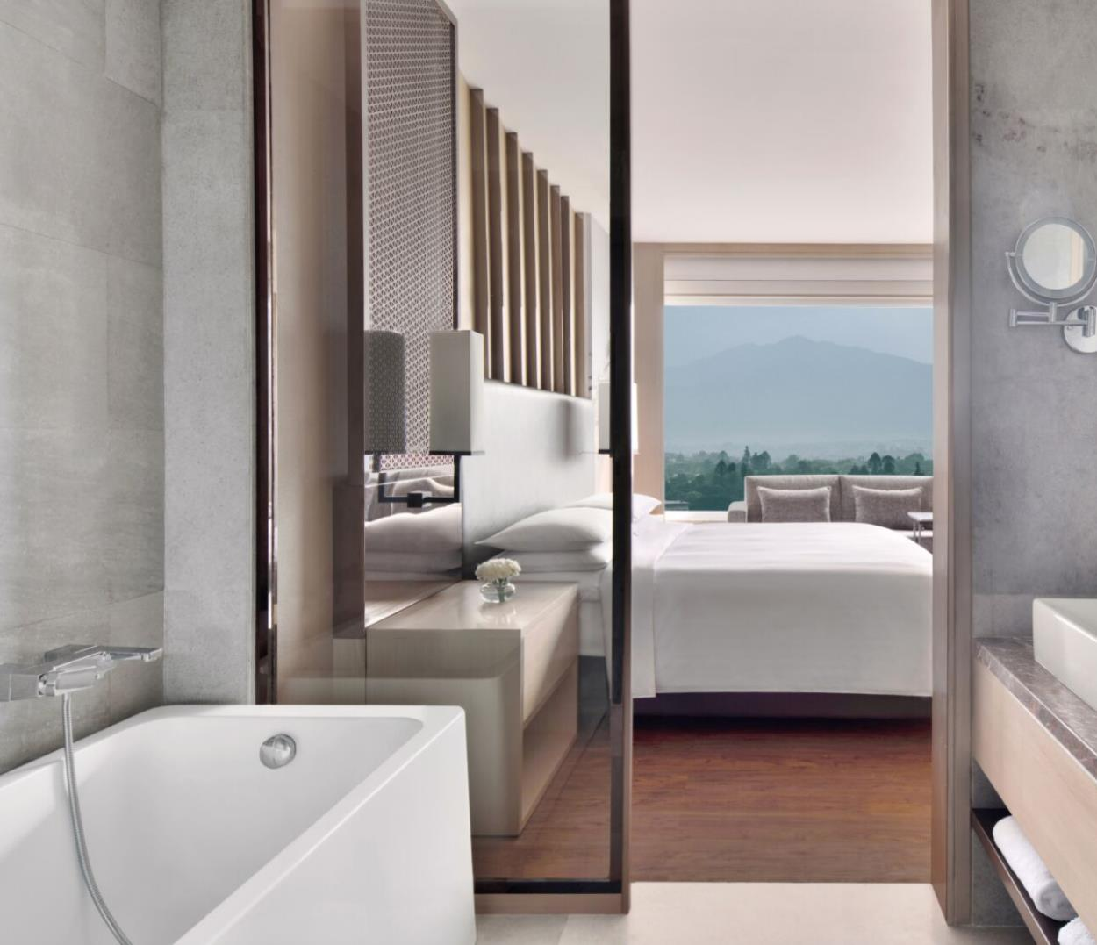
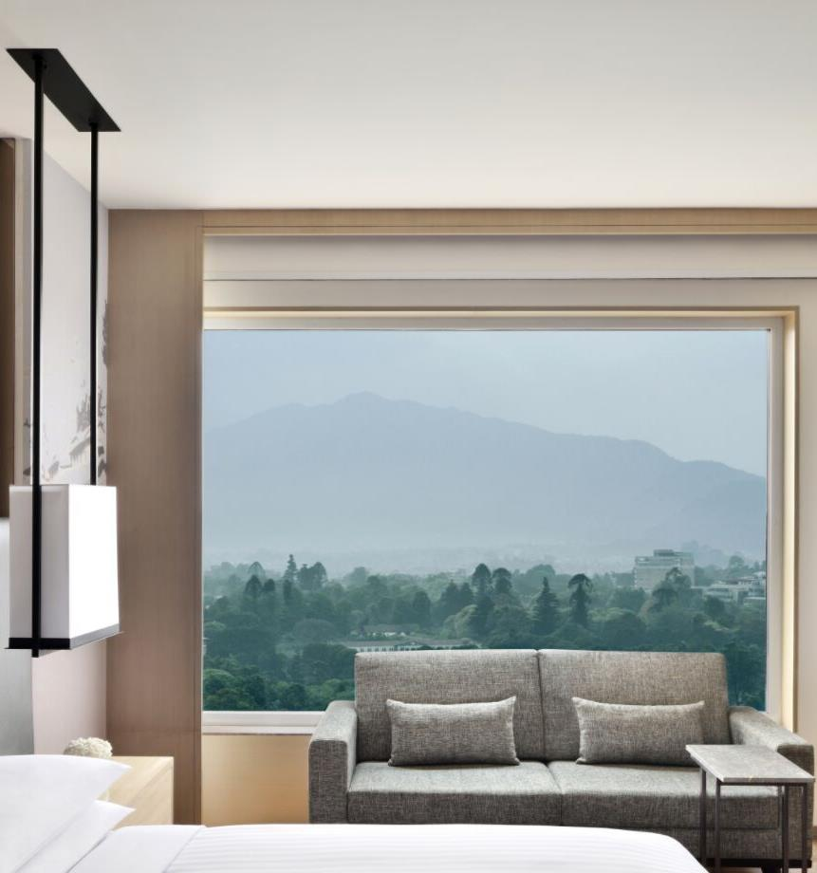
EXECUTIVE SUITE

Slide 7
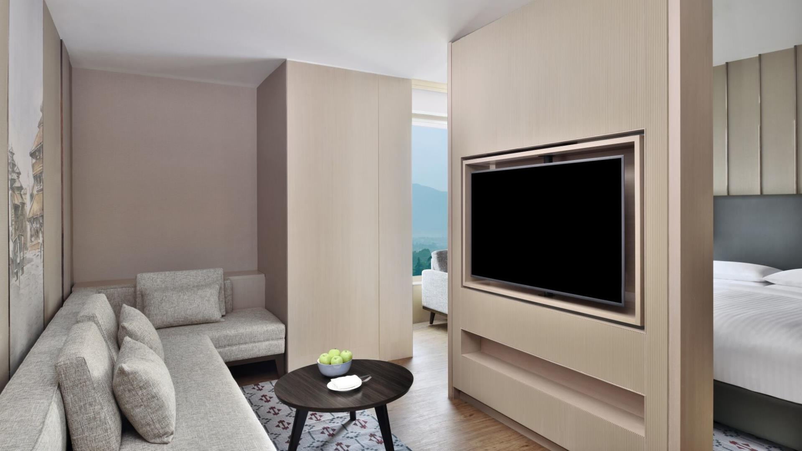
JUNIOR SUITE

Slide 8
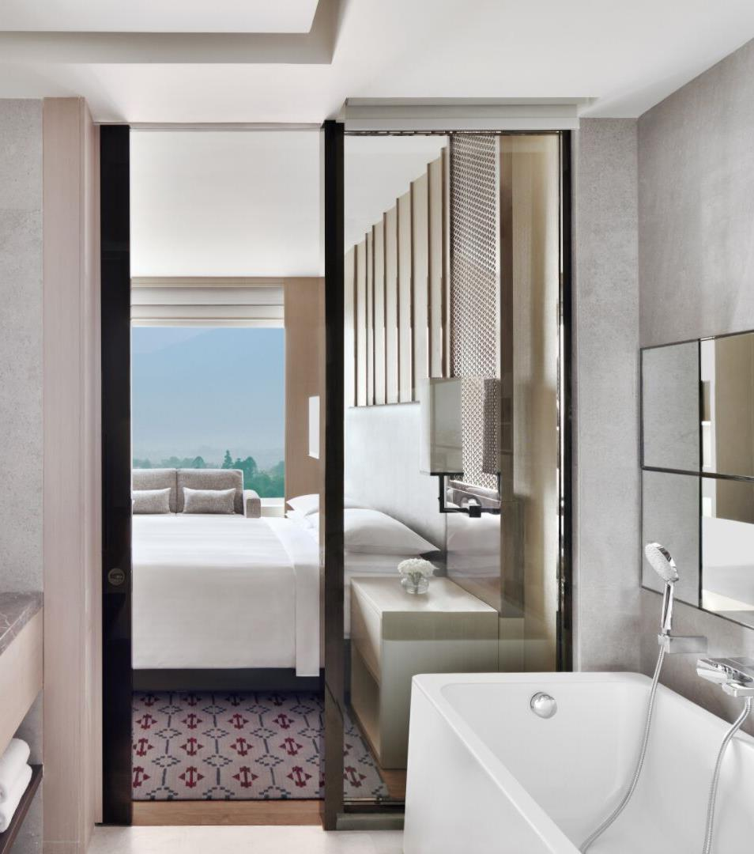
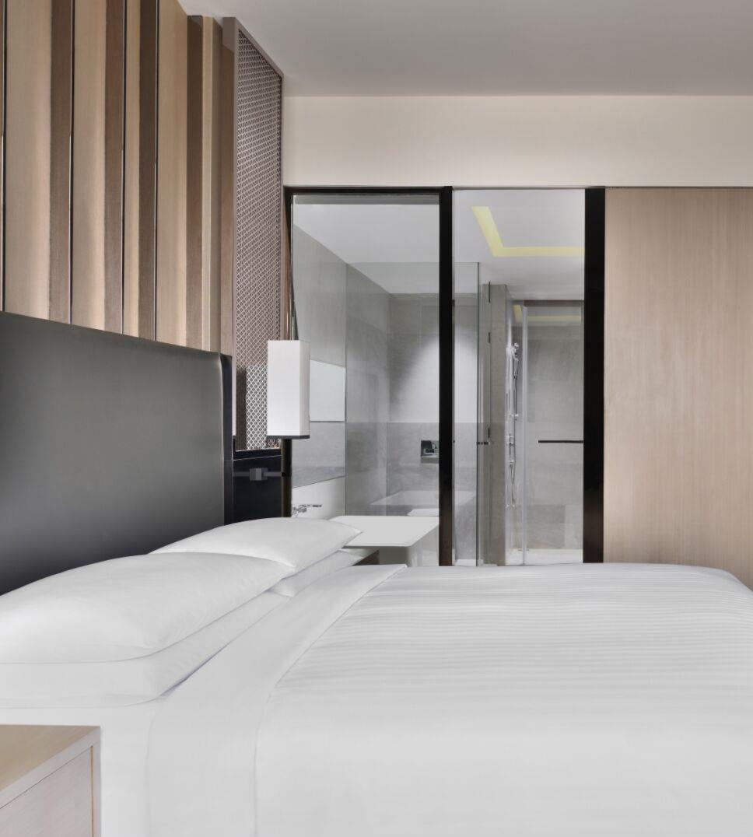
JUNIOR SUITE

Slide 9
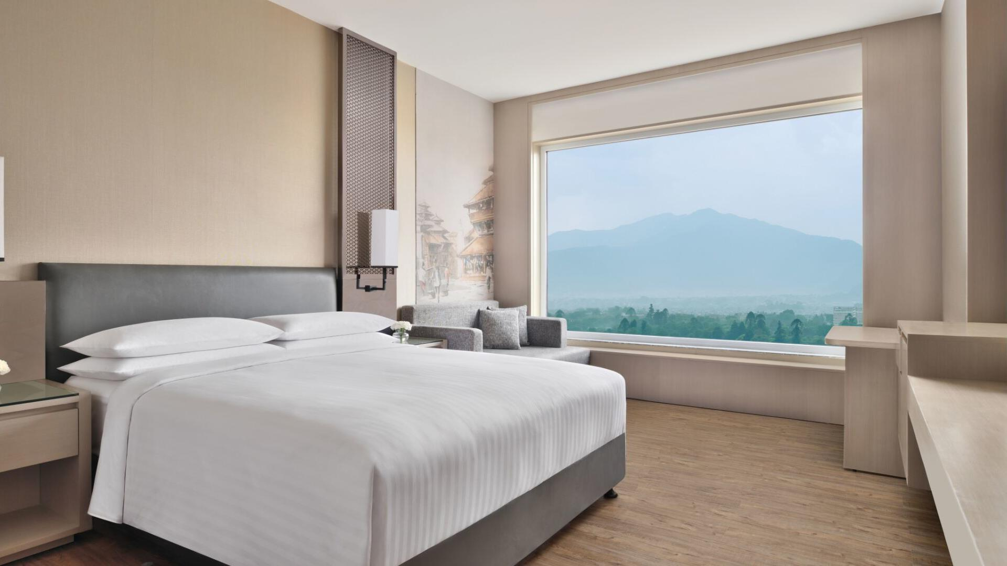
DELUXE ROOM

Slide 10
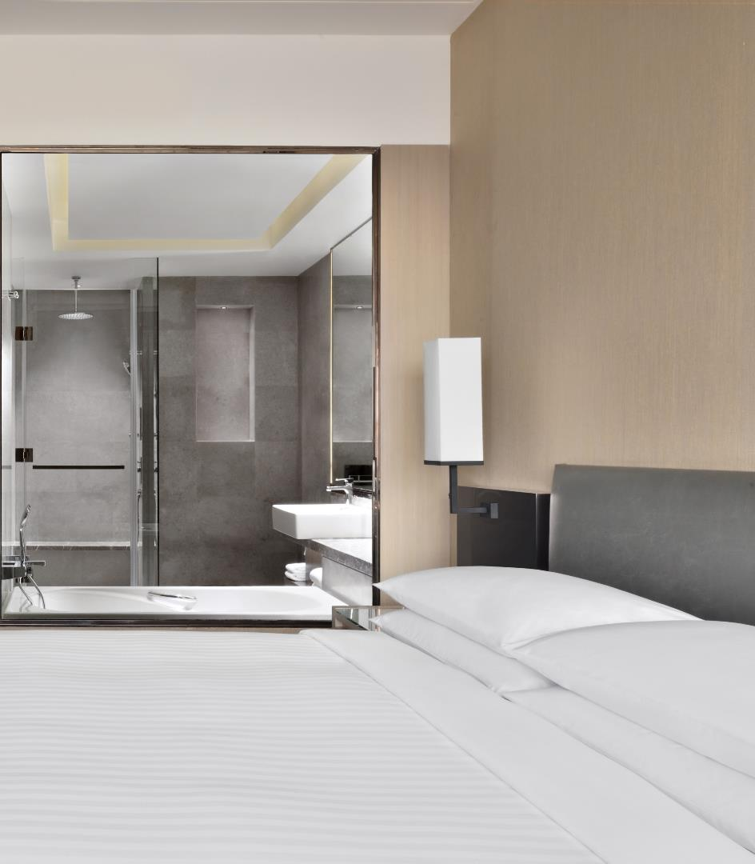
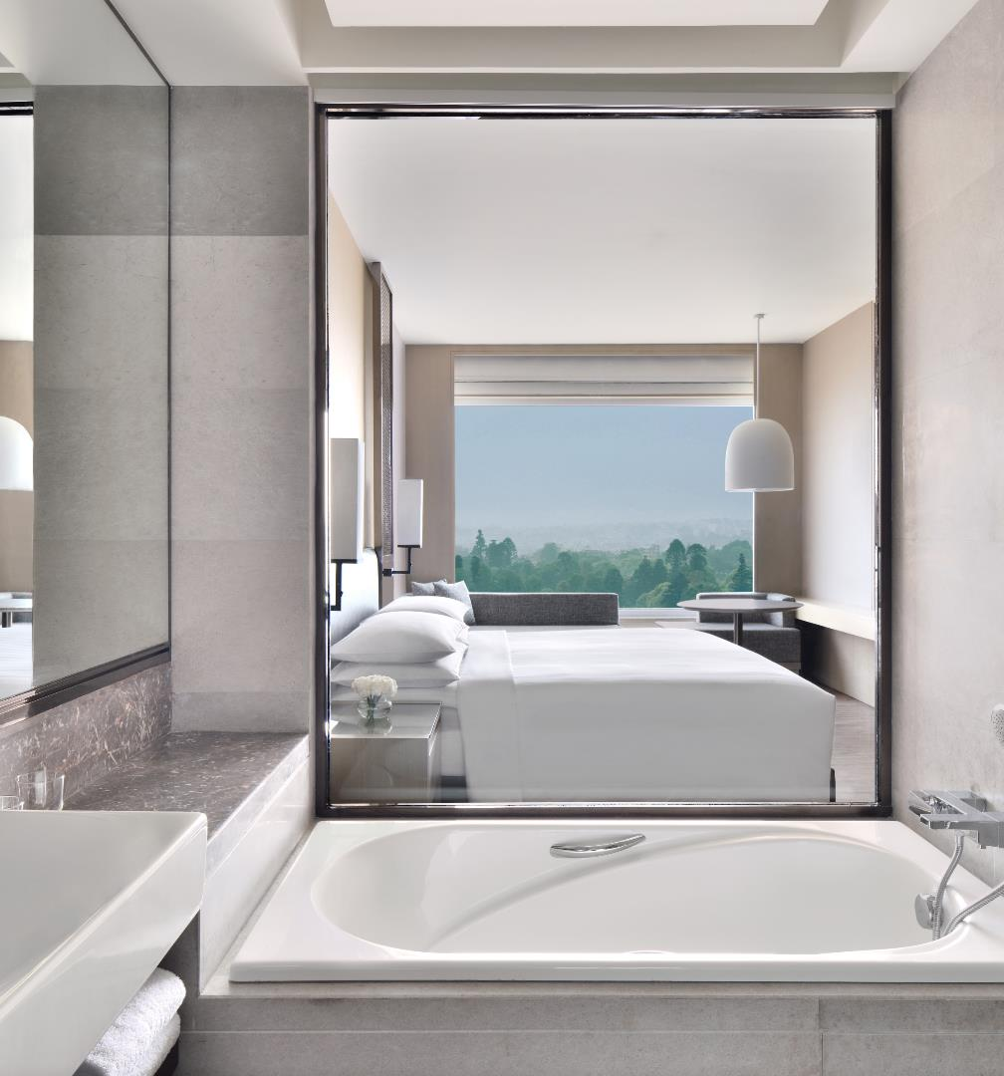
DELUXE ROOM

Slide 11
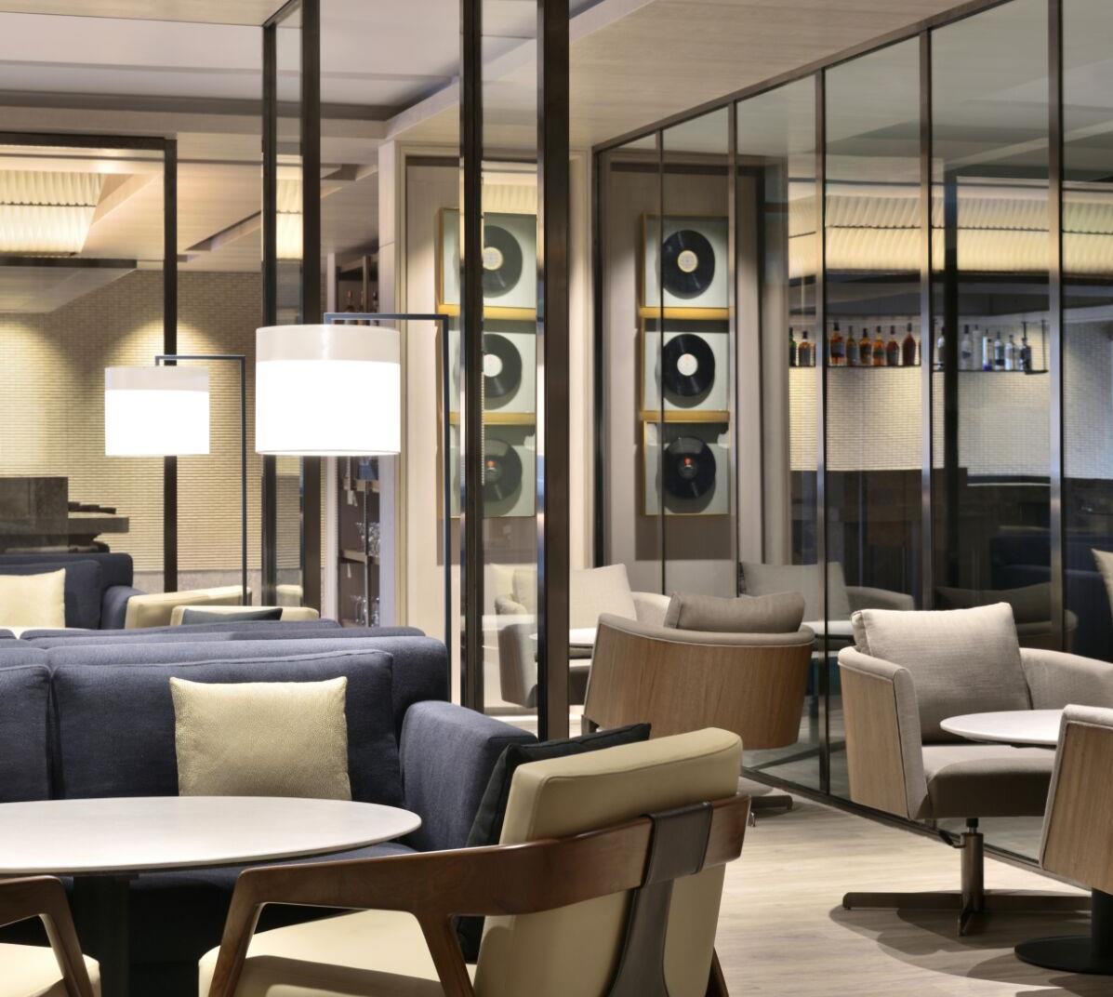

Vibrant, warm transitional space with live music, providing a quiet relaxed space for enjoying great beverages and bar snacks. It serves as the perfect destination for the millennials to discover the art of cocktails and modern mixology.
It has a beautiful alfresco area with soothing sound of cascading waterfall in the background and tranquil mountain view.
Timings:
Open Daily: 04:00pm – 01:00am
RPA Summer 2020

Slide 12
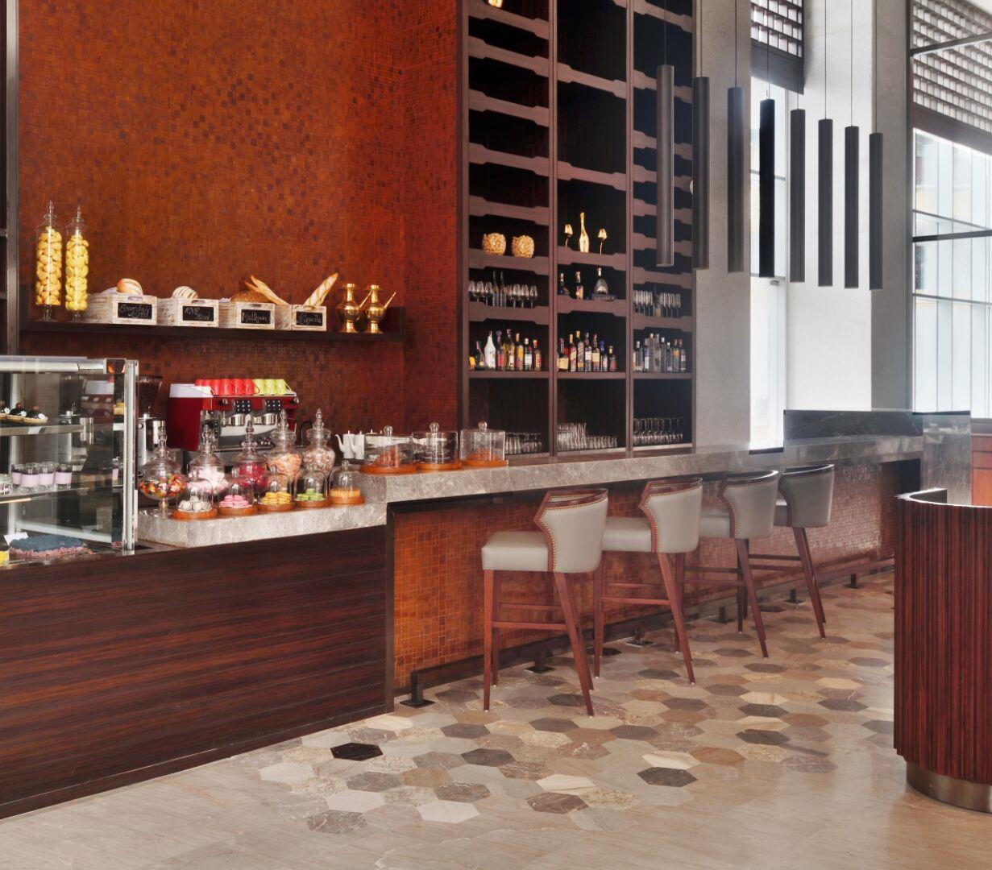

In-house patisserie serving delectable gourmet sweets, baked goodies, fresh salads and other dainties. Refreshing beverages and juices are also available for guests to enjoy onsite or for take-away.
For a unique gift, it offers an impressive wine selection, gourmet coffee beans, candies, snacks and a range of specialty items.
Timings:
Open Daily: 08:00am – 10:00pm
RPA Summer 2020

Slide 13
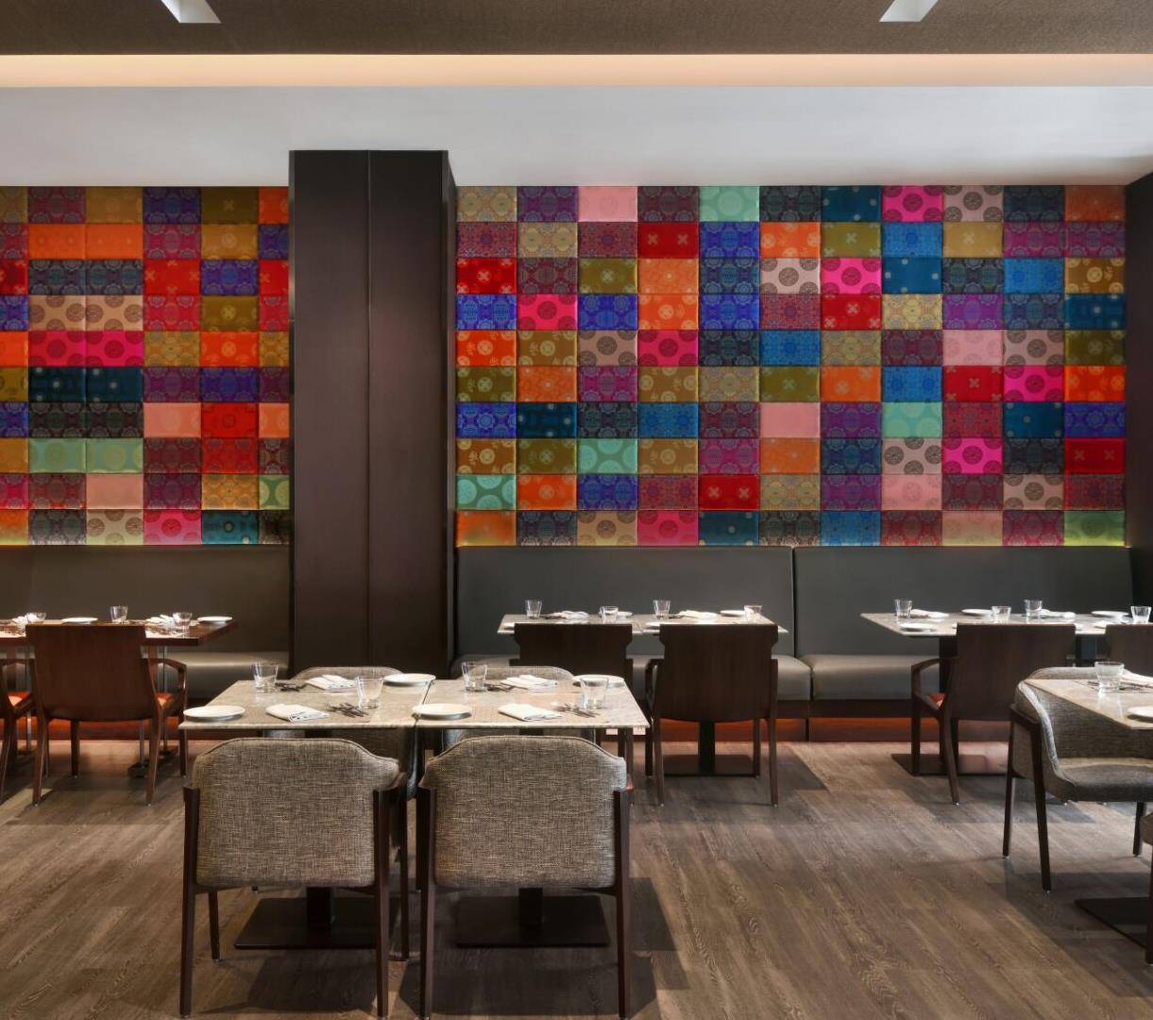

Modern, vibrant and exuberant All Day Diner, three meal restaurant showcasing interactive live-kitchen, wherein the Chef performs in front of the guest, creating an engaging experience.
The restaurant showcases local and culinary cuisine, focusing on the Nepalese, Asian, Italian and Indian cuisine.
Timings:
Open Daily: 06:30am – 10:30pm
RPA Summer 2020

Slide 14
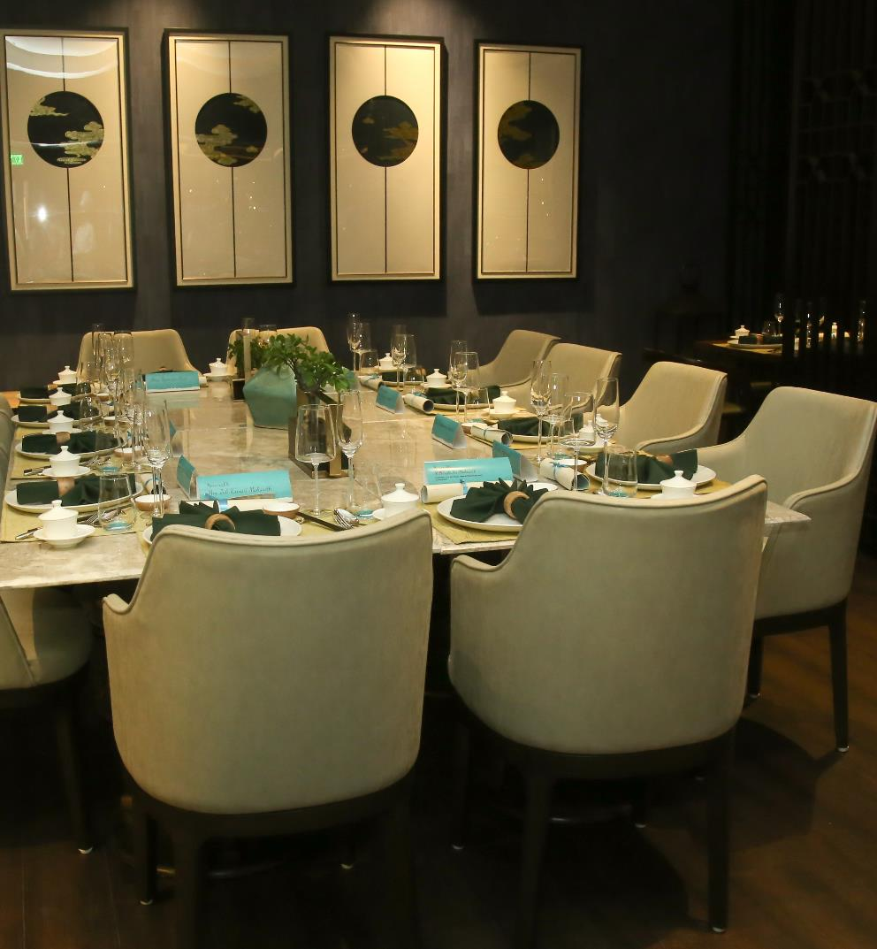

Relaxed upscale restaurant serving modern Asian cuisine featuring a live Yakitori grill, live Sushi bar and Dim sum station. The modishly designed place features a bar which serves Asian inspired cocktails.
All the dishes served are a contemporary interpretation of Thai, Japanese and Chinese cuisine.
Timings:
Open Daily: 06:30pm – 10:30pm

Slide 15
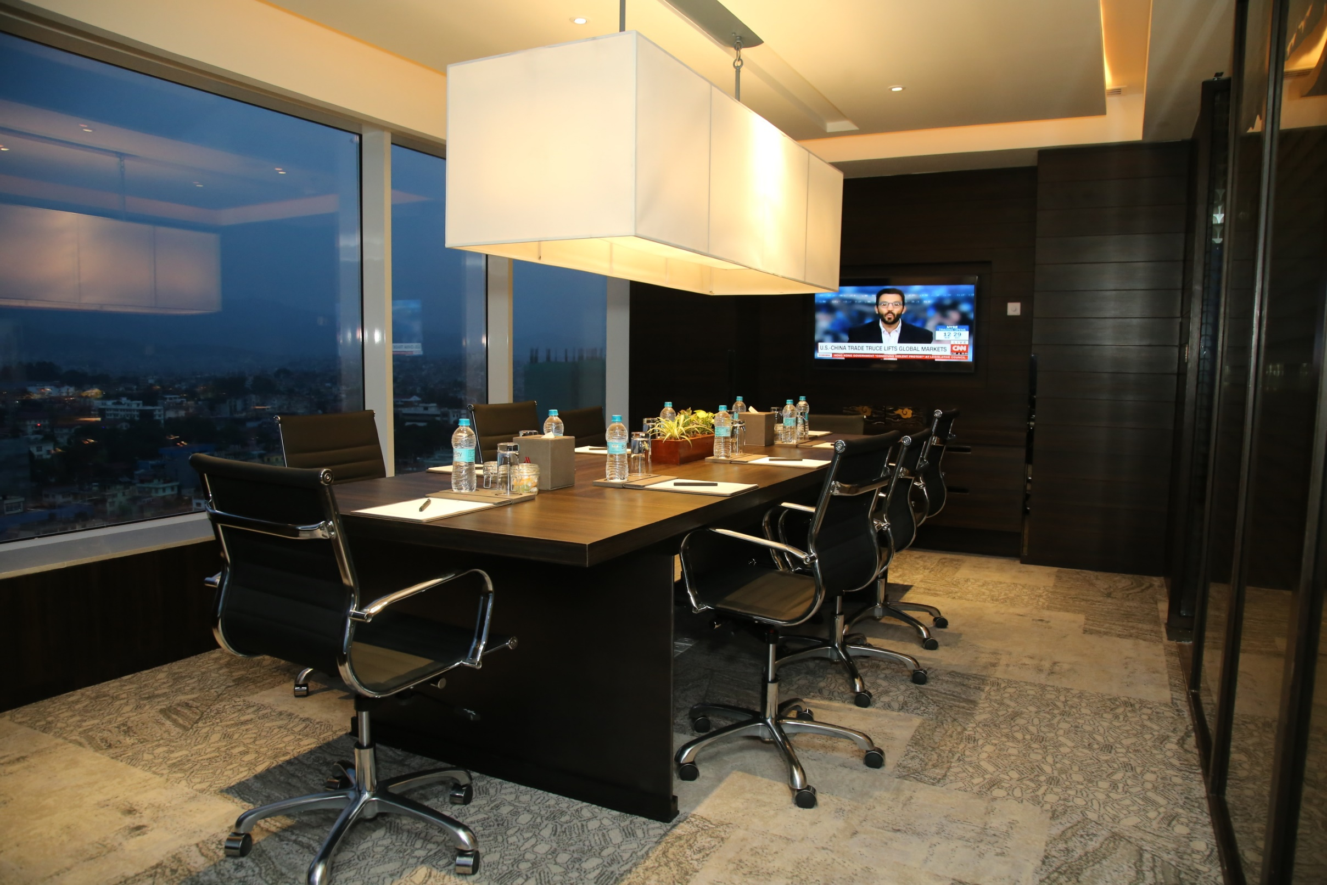
The M Club Lounge is a sophisticatedly designed space providing premiere level service to exclusive guests. It offers flexible space to work, connect and recharge. The Lounge offers the ultimate space for productivity and relaxation.
Timings:
Open All Day.

Slide 16
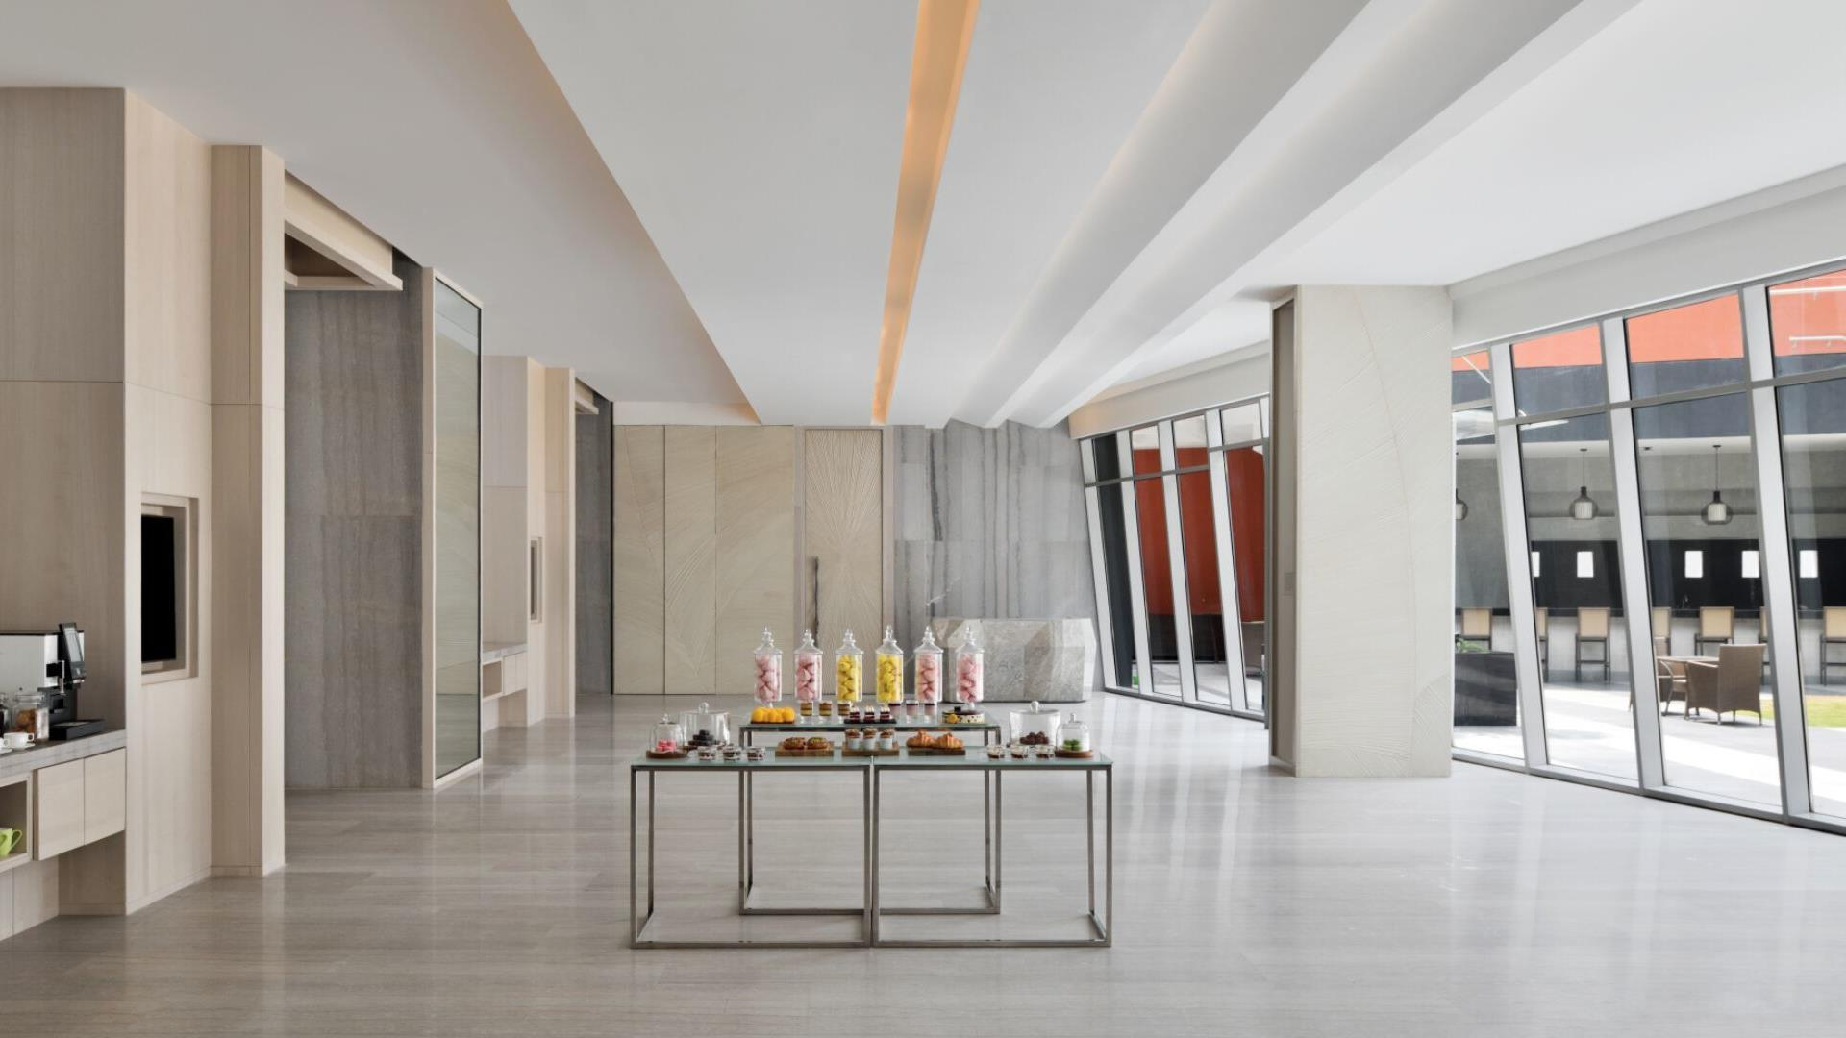
Celebrate your next event or conference in our multi-compatible meeting rooms.
With over 8000 sq ft of banquet space, inspire creativity with a gathering in our pillar less ballroom
Each of our venues offers state-of-the-art audiovisual technology and high-speed internet access.
Meetings and Events

Slide 17
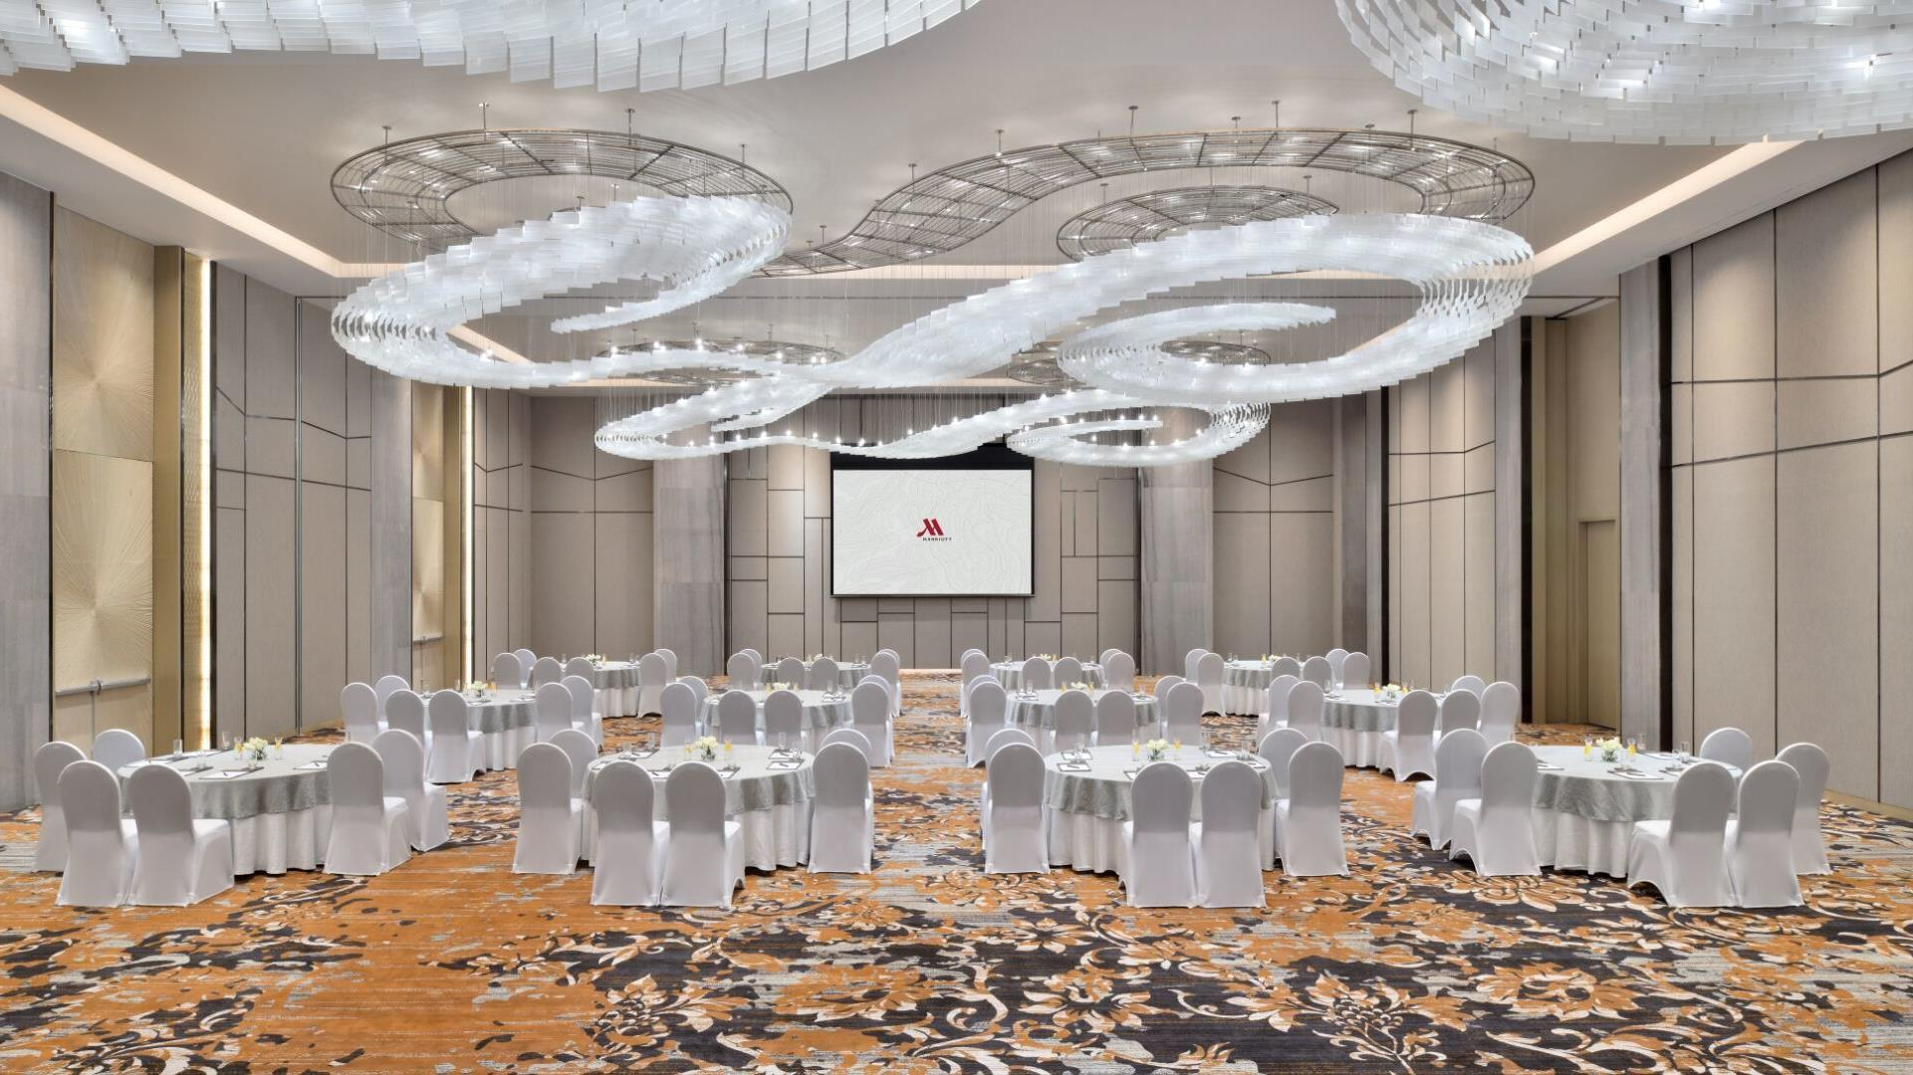
BAGMATI BALLROOM

Slide 18
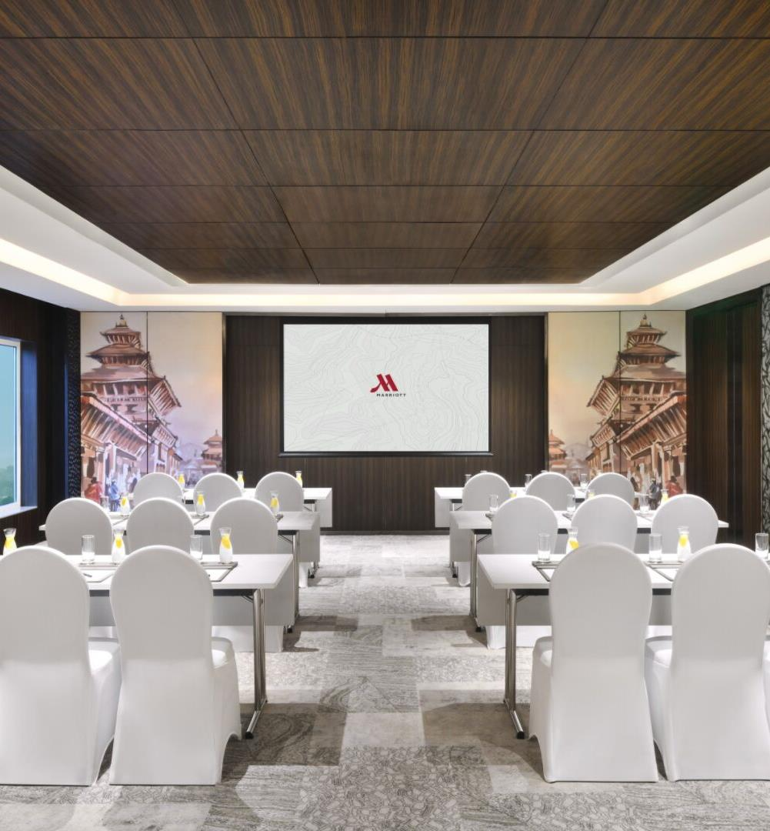
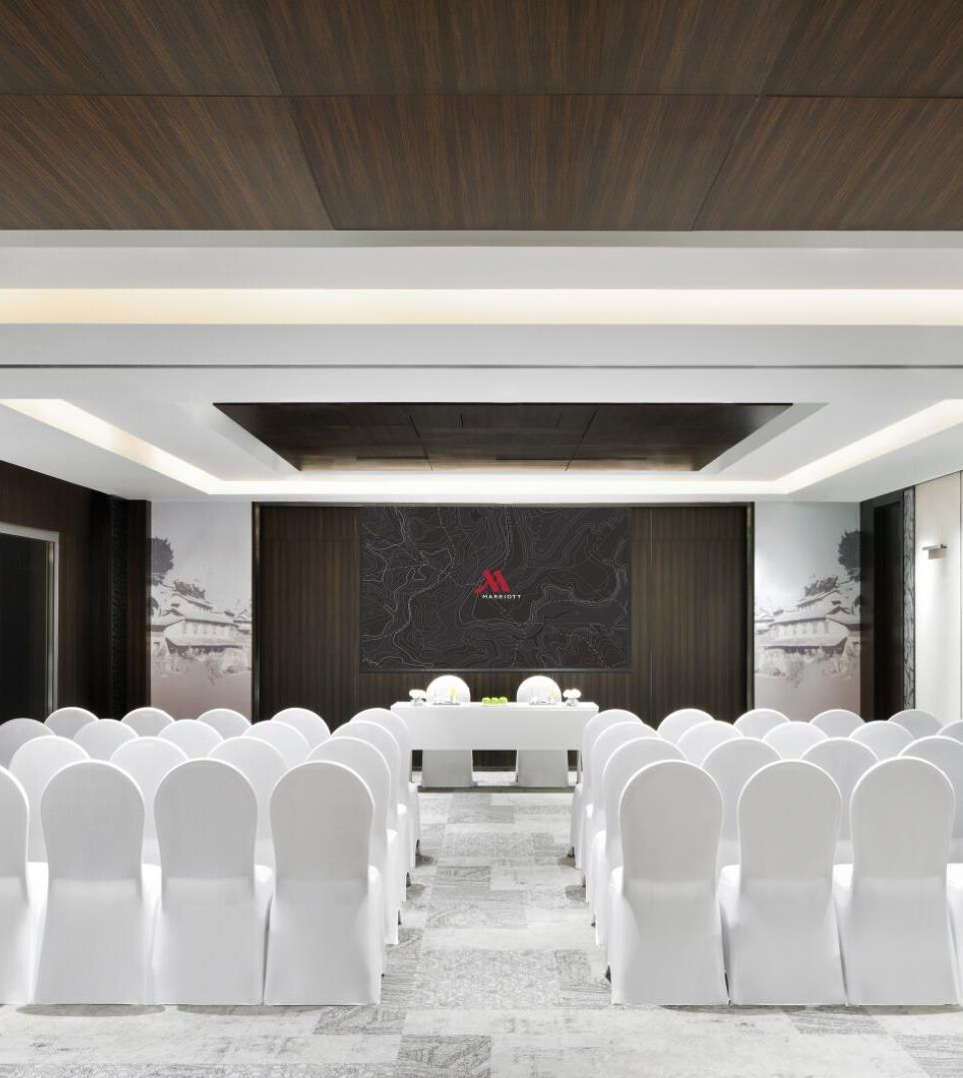

KOSHI
KARNALI

Slide 19


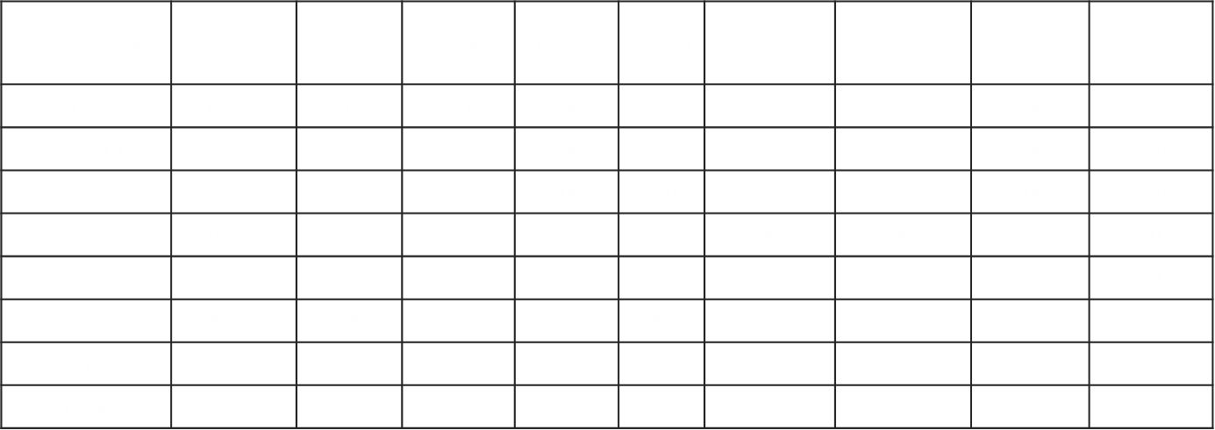
CAPACITY CHART

Slide 20
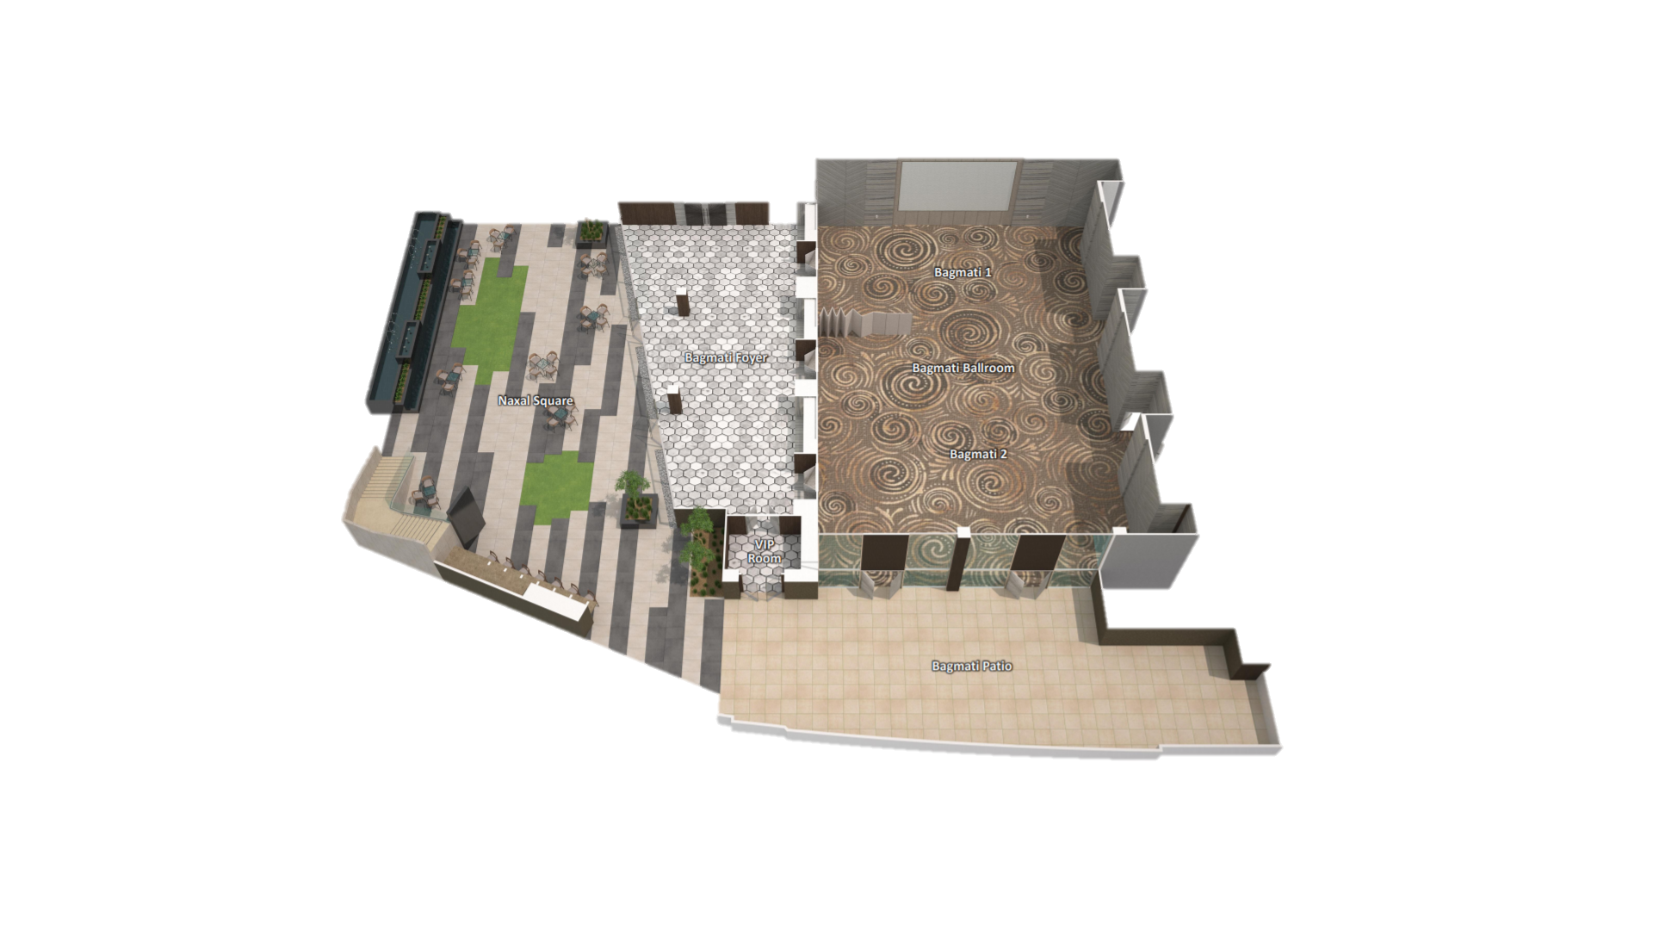
BANQUET LAYOUT

Slide 21
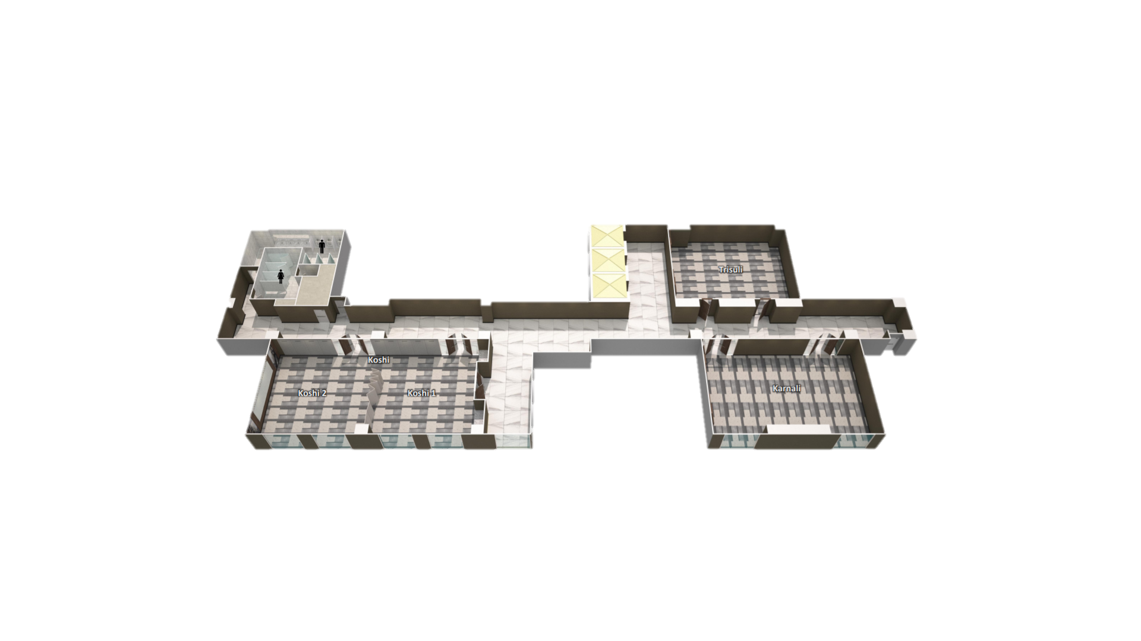
BANQUET LAYOUT

Slide 22
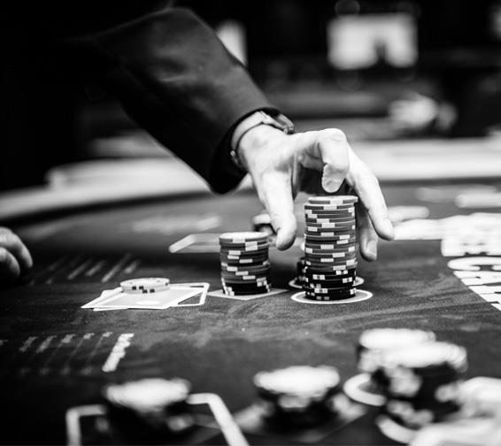
CASINO (Managed By DELTIN)
Look forward to an exciting evening at the hotel while trying hands at games and enjoying the live, world-class entertainment. You can dance away the night or put your game face on and wait for the lady luck to shine.
RECREATION – Casino

Slide 23


SPA
Designed in a contemporary style, the M wellness enjoys a beautiful rooftop pool, a Spa with private treatment rooms, steam rooms, sauna and Jacuzzi, a fitness center, aerobic studios and a relaxation area.
Timings:
Spa
Open Daily: 10:00am – 10:00pm
Pool
Open Daily: 8:00am – 06:00pm
Gym
Open Daily: 24 Hours

Slide 24
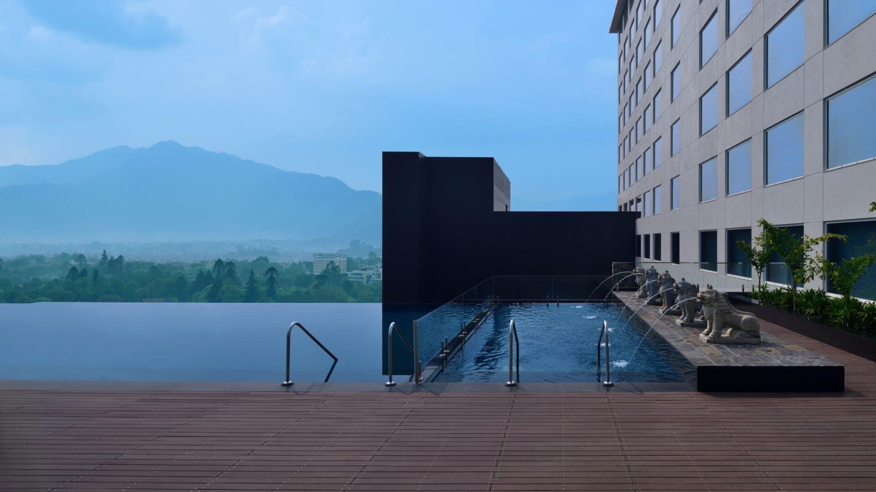

ROOFTOP POOL

Slide 25
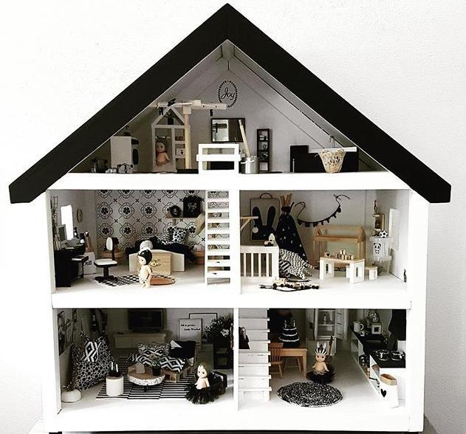
KIDS PLAY AREA
Relax and enjoy every moment of your stay while the play area keeps your junior happy and safely amused and entertained all day long.
Older kids won’t feel left out either, with a choice of virtual games to try their hands on in the specially designed zone.
RECREATION – Kids Play Area

Slide 26
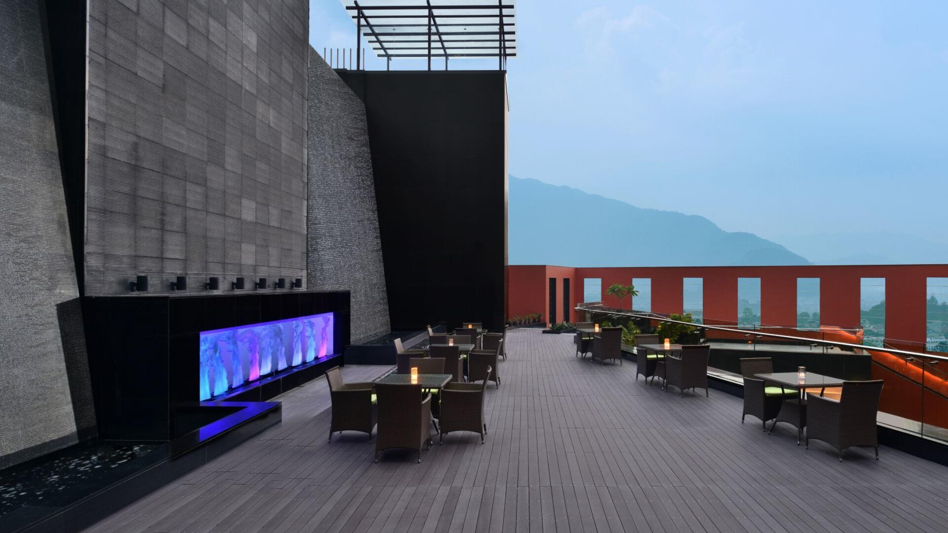
MANAKAMANA MARG, NAXAL,
KATHMANDU – 44600. NEPAL
T: +977 14443040 F: +977 14442040
E: KATHMANDU.MARRIOTT@MARRIOTT.COM
W: MARRIOTTKATHMANDU.COM

